Slide 1
Proposed regulation changes - Refrigerated display and storage cabinets
Lisa Sinclair
The Energy Efficiency and Conservation Authority
On behalf of the Equipment Energy Efficiency Program

Slide 2
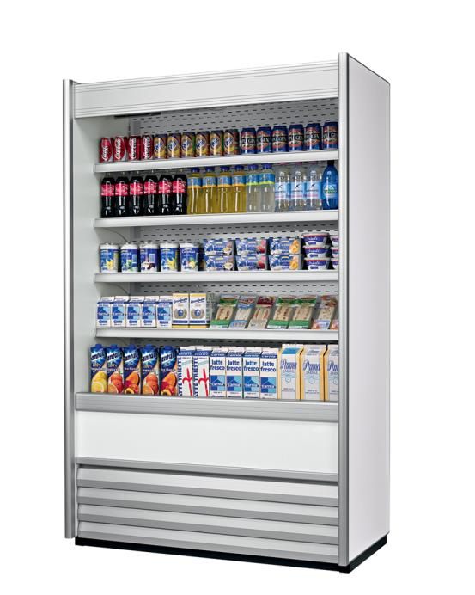
Housekeeping
Introductions
  NZ project lead

Slide 3
What we’ll cover
Overview (Purpose and E3 Program)
The Problem and Current Status
The Market
What Industry Said!
The Options and proposed EU/ISO Standards
How is energy efficiency determined by EU/ISO Standards
Implementation considerations (Deemed to Comply)
Energy Modelling and Cost Benefit Analysis
Discussion

Slide 4
Purpose
✬Proposing changes to energy efficiency regulations: refrigerated cabinets.
For you…
Get information
Check our assumptions
Add buyers/users view
Flag unexpected outcomes
Make a submission!
Nominees for technical working group
For us…
Improve our assessment
Inspire submissions!
Develop Regulations that have strong compliance & enforcement ability.

Slide 5
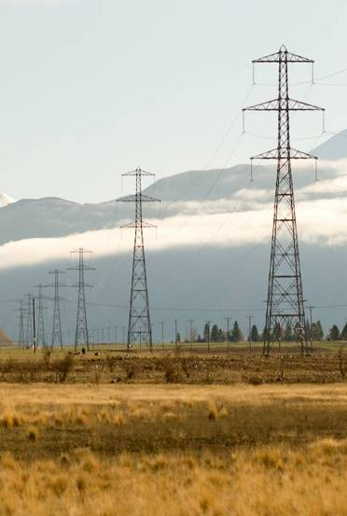
Why energy?
NZ and AU government policy to consider energy. International best practice to use regulation to fix market issues in this area.
Improve energy security by reducing demand.
Defer expensive new generation. Keeps prices low compared to building new plant.
Reduce Greenhouse gases from energy production. Climate change.

Slide 6
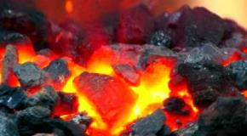

Why should government intervene?
For common good – drive collective action that can’t be seen/ taken by individuals.
Priority appliance – signed off by COAG ministers & NZ Minister of energy and resources.
SIZE OF “PRIZE” is huge
Estimated 98,000 cabinets were sold in 2015
Used > 7,100 GWh electricity
If least efficient 10% models improved from 2017…
By 2035, reduce GHG by 594 kt CO_{2-e}
Typical paybacks of < 2 years for glass door merchandisers

Slide 7
Why doesn’t energy efficiency take off?
Lack of awareness (clarity, timing of info, size & nature of lifetime cost/opportunity)
Energy = Low priority – day to day – or production/health
Capital cost – or – low risk
Split incentives – buyer doesn’t pay for energy
$ electricity doesn’t reflect environmental price
✬ Buyers use/pay for more energy than necessary

Slide 8


E3 Program
E3 = Equipment Energy Efficiency
Administered by Au Department of the Environment & Energy
Joint Au-NZ (2002)
  Commonwealth GEMS Act & Determinations
  NZ EECA Act & EE (EuP) regs
Variety of voluntary/ mandatory tools to encourage more energy efficient equipment to be sold

Slide 9

MEPS & labelling
Minimum Energy Performance Standards
Labelling (whiteware)
More efficient items to enter stock
Align with international standards
New technology
Compliance baseline

Slide 10
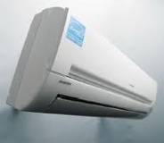
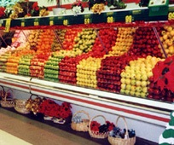
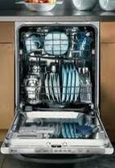
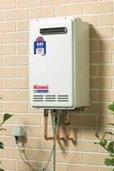
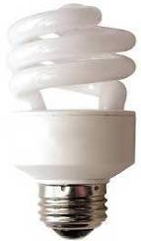
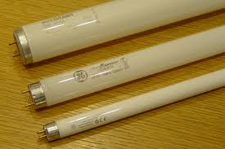
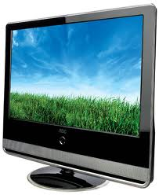
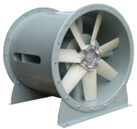
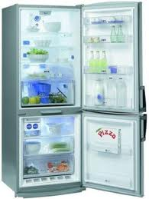
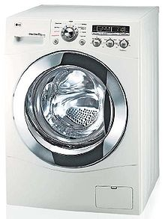
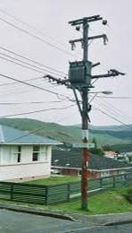
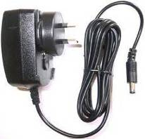
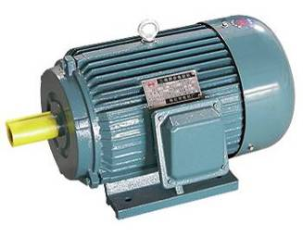
MEPS & labels applied many types of domestic, commercial & industrial products.

Slide 11
History of refrigerated cabinet regulation
MEPS since 2003. On 24/7, large appliances.
AS 1731.2003 “Refrigerated Display Cabinets”
Part 14: AS/NZS
Cabinet types, metrics, the test method & MEPS levels
Does not include all storage cabinets, vending machines or ice machines. Complex & confusing. Outdated.
EU, Canada, US, Mexico & China also have test levels & standards
  2011: In From the Cold Strategy on Non-Domestic Refrigeration
  2013 Product profile – consultation Au/NZ

Slide 12
E3 Process to Develop Regulations
1. Product Profile
2. Research
3. RIS * your input *
STANDARDS DEVELOPMENT
4. Decision paper (private)
Ministerial approval
MEPS
Commence
2013
2019 +

Slide 13
This isn’t new to most of you!
✬ if MEPS / labelling becomes law, they only apply to:
  products you want to continue importing or manufacturing,
  or new models you want to bring into the market.
  The least efficient models will no longer be legal for sale
  All models within the scope of the Standard will have to pass the efficiency lab test (get a certificate)
  Register your models through the Energyrating website
  Listed publically with their energy efficiency
  Compliance checks – including actual efficiency vs claims
  In NZ, give EECA your sales data after each year

Slide 14
Proposals: main changes
Adopt/adapt European & ISO test standards
– display and storage cabinets
Align with European Regulations (MEPS levels)
Cover a wider range of cabinet types
Increase in MEPS levels for some types
Rather than ‘single’ class MEPS move to ‘group’ MEPS
No “Family” defn = swap-in/out components display cabinets
Or…local MEPS levels
Labelling
5 options

Slide 15
Options overview (pg 20)
 | Option 1 – BAU | Option 2 –AU/NZ MEPS 10% | Option 3 –AU/NZ MEPS 30% | Option 4 –EC MEPS | Option 5 – non-regulatory options (in addition to BAU
Move to International ISO and EN test methods | ✗ | ✓ | ✓ | ✓ | ✗
New AU/NZ MEPS levels | ✗ | ✓ | ✓ | ✗ | ✗
EC MEPS levels | ✗ | ✗ | ✗ | ✓ | ✗
Labelling | ✗ | ✓ | ✓ | ✓ | ✓

Slide 16
Option 1: BAU
No change.
Display cabinets remain regulated.
Storage cabinets primarily unregulated.
No change in MEPS levels.

Slide 17
Option 2:
EU and ISO test methods:
  Refrigerated display cabinets: Adopt/adapt ISO test method – ISO 23953 “Refrigerated display cabinets”.
    Exclude beverage vending machines.
  Storage cabinets: EN 16825 “Refrigerated Storage Cabinets and counters for professional use”.
    Exclude blast cabinets, condensing units, process chillers.
  Small ice-cream freezers EN 16901 [draft]
  Commercial Beverage coolers EN 16902 [draft]
  Refrigerated display scooping cabinets for gelato EN 16838 [draft?]
AU/NZ MEPS: set levels per group.
  Levels will affect least efficient 10% of models per group.
Labelling

Slide 18
Option 3:
EU and ISO test methods: as in option 2…
  Refrigerated display cabinets: Adopt/adapt ISO 23953
  Storage cabinets: EN 16825
  Small ice-cream freezers EN 16901 [draft]
  Commercial Beverage coolers EN 16902 [draft]
  Refrigerated display scooping cabinets for gelato EN 16838 [draft?]
AU/NZ MEPS: set levels per group.
  Levels will affect least efficient 30% of models per group.
Labelling

Slide 19
Option 4: (Preferred)
EU and ISO test methods: as in option 2 & 3…
  Refrigerated display cabinets: Adopt/adapt ISO 23953
  Storage cabinets: EN 16825
  Small ice-cream freezers EN 16901
  Commercial Beverage coolers EN 16902
  Refrigerated display scooping cabinets for gelato EN 16838
Align with European MEPS (set per group).
  MEPS in EU regulations – already in force for Storage cabinets.
  Not yet published for all others. Likely to come into in force in 2019.
Labelling.
✬Affects approx. 14% cabinets.
Some groups more heavily affected… particularly Storage cabinets

Slide 20
Option 5: non-Regulatory (in addition to BAU)
Incentive schemes
Voluntary efficiency Standards, certification or labelling programmes
Buyer education programmes
✬Assumptions, modelling to follow.

Slide 21
The Problem and Current Status

Slide 22
Summary of ‘The Problem’
The current Standard is complex and confusing
The Standard does not provide complete coverage of the market
MEPS levels no longer protect buyers
MEPS levels and Test Methods are not aligned with international standards
Difficulties with the application and coverage of AS 1731 are compounded by market barriers or failures:
  Refrigerated commercial cabinets sold in retail stores where energy efficiency labelling could benefit buyers comparing appliances
  Information about energy efficiency may be unavailable or difficult to access, or may be difficult to independently assess, reducing its value to buyers
  Split incentives where buyers aren’t the users (i.e. companies hire out or courtesy-supply branded product-specific fridges but do not pay for the electricity)

Slide 23
Regulations, Legislation and Standards
The Greenhouse and Energy Minimum Standards Act 2012 or GEMS Act and the requirements in the associated GEMS (Refrigerated Display Cabinets) Determination 2012 became the national framework for regulating the energy efficiency of Refrigerated Display Cabinets throughout the States and Territories of Australia from 1 October 2012.
AU

Slide 24
Regulations, Legislation and Standards
Energy efficiency and conservation Authority (EECA) implements the Government’s energy priorities in the areas of energy efficiency, energy conservation and renewable energy
Ministry of Business, Innovation and Employment (MBIE) is the policy advisor to the government on the energy sector, including energy efficiency
EECA’s long-term strategy is framed by the New Zealand Energy Efficiency and Conservation Strategy (NZEECS). The NZEECS is required by the Energy Efficiency and Conservation Act 2000 and is a companion document to the New Zealand Energy Strategy (NZES)
NZES sets out the role that energy will play in the economy, with “Achieving efficient use of energy” one of the priorities which requires “better consumer information to inform energy choices”
NZ

Slide 25
Regulations, Legislation and Standards
The legislation still references and retains the existing efficiency levels and test requirements that were set out in the AS 1731 series of standards and in particular AS 1731-14: 2003:
  Captures more than 50 products, across four temperature classes (M1, M2, L1, L2)
  The market for RDCs in AU and NZ is complex and diverse
  These products include units ranging in size from multi-door cabinets in large supermarkets more than 7 meters in length to counter-top glass cabinets designed to display cakes or drinks

Slide 26
AS 1731: 2003 Refrigerated Display Cabinets
The Part 14 of the standard, AS 1731-14: 2003 Minimum energy performance standard (MEPS) requirements, describes the test methods and sets out the requirements for determining the energy performance of RDCs and the maximum energy consumption permitted.
It also sets out requirements for High Efficiency performance (HEPS) of models.
The standard contains a number of diagrams in the form of cross-sectional drawings that illustrate the typical physical aspects of the cabinet Types.

Slide 27
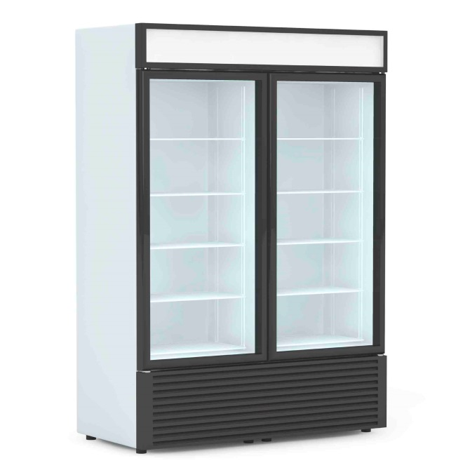
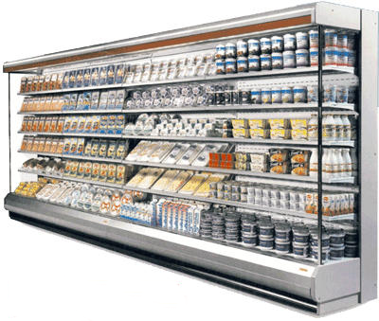
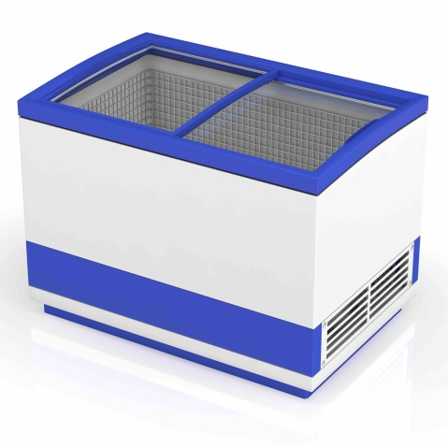
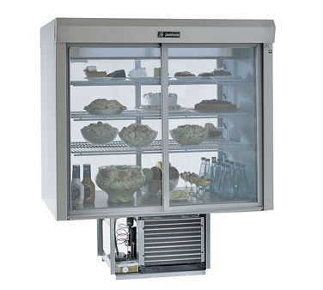
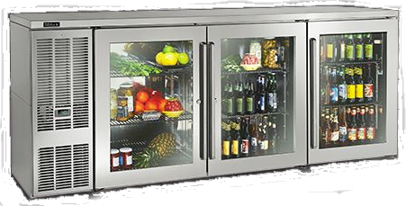
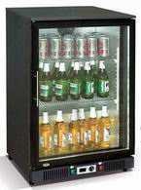
Refrigeration Display Cabinets

Slide 28
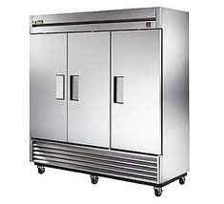
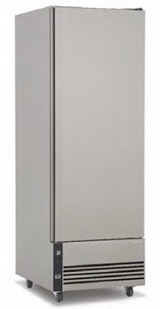
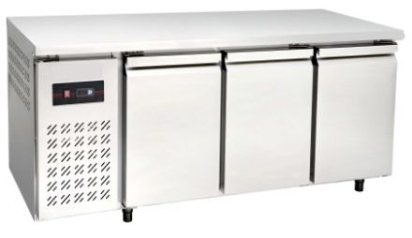
Refrigeration Service Cabinets

Slide 29
How is energy efficiency of an RDC determined?
The key metrics for efficiency of an RDC are:
  Total Energy Consumption (TEC) in kWh per day
  Total Display Area (TDA) in m²
The minimum energy performance (MEPs) is the maximum allowable energy consumption per day per m² of display area and therefore is the result of dividing the TEC by the TDA measured in kWh per day per m²

Slide 30
The Market

Slide 31
Steady Growth in Hospitality & Food Retailing
Seasonal peaks at Christmas
Steady growth of around 5% p.a. versus population growth of 1.5% over the last 10 years (1.2% in NZ)
Steady historic rates of growth in the volume of refrigerated food, frozen foods and chilled beverages; and therefore RDCs and RSCs
Sales growth of cabinets have slowed since the 1990s from around 7% p.a. to 4% over the past decade to around 2.5% p.a. (assumed in RIS model)

Slide 32
Market sales, stock and applications
Three methodologies were used to assess the existing stock of equipment in Australia during the RIS process, being:
Market sales data, profile of sales by cabinet type, average lifespans and growth rates to develop a stock model from 2000 to 2030 for each country
An estimation of stock based on the number of outlets where the devices are used, multiplied by the number of each category (i.e. integral RDC; remote RDC and RSC)
A comparison of Australian and New Zealand stock estimates based on scaling the Ecodesign 2013 EU-28 stock estimates on a per capita basis

Slide 33
Grouped cabinet types
Classifications for group types
I | - | - | Integral or incorporated condensing unit
R | - | - | Remote condensing unit
S | - | - | Storage cabinet
- | R | - | Refrigerator
- | F | - | Freezer
- | - | H | Horizontal case configuration
- | - | V | Vertical case configuration
- | - | # | Type of cabinet requiring special assessment due to high sales volumes and/or efficiency characteristics

Slide 34
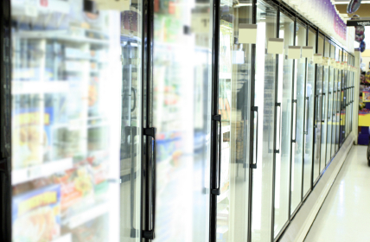

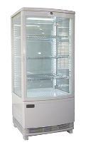

Sales profile for AU and NZ in 2013
RFV = Remote Freezer Vertical
RRV-2 = Remote Refrigerated Vertical Cabinet (Open, medium temp)
IRV-4 Integral Refrigeration Vertical Cabinet with Glass Doors
IFH-5 = Integral Freezer Horizontal with Lid
Source: NZ Industry data from NZ Energy Efficiency (Energy Using Products) Regulations 2002

Slide 35
Sales Estimates
Pre-Charged Imports of Integral RDC and RSC
2006 | 2007 | 2008 | 2009 | 2010 | 2011
65,354 | 66,772 | 62,534 | 57,991 | 85,019 | 91,941
Average 63,000
Extraordinary sales event
Allowing for remote RDCs (i.e. no refrigerant charge) and local manufacturing during this period results in a conservative sales estimate of 75,000 to 80,000 pieces p.a.
Adopted NZ sales profile by type
Checked sales profile was consistent with Ecodesign 2013 EU-28
Applied growth of 2.5% p.a.
Calculated stock profile based on average lifespans
Integral RDCs 11 years; Remote RDCs 13 years; and, Storage cabinets 11 years
759,000 RDCs and RSCs in AU in 2013
Other two methods corroborated this estimate within ± 5%
Source: Cold Hard Facts 2 stock model
AU

Slide 36
AU Sales Forecast by Product Group

Slide 37
NZ Sales Forecast by Product Group
Total = 15,000
Storage Cabinets = 3,400 (22.5%)
RRV-2 = Remote Refrigerated Vertical Cabinets (Open, medium temp) = 8,200 (11%)
IRV-4 = Integral Refrigeration Vertical Cabinet with Glass Doors = 7,000 (47%)

Slide 38
Market data
Consultation Questions:
Does the sales estimate seem reasonable?
21. We have used NZ sales mix data and checked with European market data to estimate sales mix of cabinets in Australia. Do you accept this as a viable approach to estimating the sales mix in Australia?
22. Can you provide more accurate market data including the stock and sales estimates?

Slide 39
Summary of industry submissions
Consensus from submitters that Australian and New Zealand standards should align with the International test method ISO 23953 for display cabinets, while retaining the option for local standards to be amended
All submitters offered support for ‘deemed to comply’ provisions for low volume and custom production of cabinets under the EN approach
The feedback showed a vast amount of technical knowledge by some manufacturers, who outlined several inconsistencies with the current standard and its interpretation
All submitters (with the exception of one small company) supported an expansion of measures to cover storage cabinets
There was strong support for the need to update and rationalise MEPS. Although there were mixed comments as to what the MEPS levels should be (i.e. difficult to assess without running examples)

Slide 40
Summary of industry submissions
End Users did not tend to consider energy over price and suppliers sold certain types of cabinets into ‘type-price’ brackets which did not differentiate between their respective efficiency
There was broad support for a mandatory energy rating label of some kind (preferably in electronic form on-line or in the literature)
No interest was expressed in a voluntary labelling scheme, until issues with the current MEPS or HEPS (high efficiency performance specifications) levels were resolved
Labelling needed to be accompanied with education of buyers so they did not simply buy the unit that was labelled as more efficient when a different class (temperature of operation, configuration) would use far less electricity

Slide 41
What’s Proposed

Slide 42
Options Summary
 | Option 1 – BAU | Option 2 –EN and ISO test methods, AU/NZ MEPS 10%, labelling | Option 3 – EN and ISO test methods, AU/NZ MEPS 30%, labelling | Option 4 – EN and ISO test methods, EC MEPS, labelling | Option 5 – non-regulatory options (in addition to BAU
Move to International ISO and EN test methods | ✗ | ✓ | ✓ | ✓ | ✗
New AU/NZ MEPS levels | ✗ | ✓ | ✓ | ✗ | ✗
EC MEPS levels | ✗ | ✗ | ✗ | ✓ | ✗
Labelling | ✗ | ✓ | ✓ | ✓ | ✓
Modelled date of implementation | N.A. | 2017 | 2017 | 2017 | 2017

Slide 43
Policy options under consideration
 | Standards publication date | MEPS levels publication date in Europe | MEPS regulation date in Europe | Parts of standards or regulations that are not being considered for AU and NZ under this current proposal
ISO 23953 Refrigerated display cabinets | Published | mid 2018 | mid 2019 | Beverage Vending machines
EN 16825 Refrigerated storage cabinets and counters for professional use | Published | Published | July 2016 | Blast cabinets, condensing units and process chillers
EN 16902 Commercial beverage coolers | Jan 2017 | mid 2018 | mid 2019
EN 16901 Small ice-cream freezers | Jan 2017 | mid 2018 | mid 2019
EN 16838 Refrigerated display scooping cabinets for gelato (soft scoop) | Published | mid 2017 | mid 2019

Slide 44
How is energy efficiency of an RSC determined?
The key metrics for efficiency of an RSC are:
  Total Energy Consumption (TEC) in kWh per year
  The refrigerated net volume in m³ is the preferred metric (not Total Display Area)
  Energy Efficiency Index (EEI), a ratio compared to a Standard Annual Energy Consumption
  Efficiency Grades (A to G)

Slide 45
Equation to calculate the EEI of RSC
Energy Efficiency Index (EEI) = (AEC/SAEC) ×100
Annual Energy Consumption (AEC) of the cabinet in kWh/year
AEC=E24h ×af ×365
E24h = Energy consumption of the cabinet over 24 hours
af = Adjustment factor to be applied only for light-duty cabinets
Standard Annual Energy Consumption (SAEC) of the cabinet in kWh/year
SAEC= M × Vn +N
Vn = Net volume of the appliance, which is the sum of net volumes of all compartments of the cabinet, expressed in litres
M and N coefficients for different types of cabinet (VC, VF, HC and HF)
EEI is a ratio compared to a Standard Annual Energy Consumption

Slide 46
Energy Efficiency classes for RSC
Energy Efficiency Class | EEI
A+++ | EEI < 5
A++ | 5 ≤ EEI < 10
A+ | 10 ≤ EEI < 15
A | 15 ≤ EEI < 25
B | 25 ≤ EEI < 35
C | 35 ≤ EEI < 50
D | 50 ≤ EEI < 75
E | 75 ≤ EEI < 85
F | 85 ≤ EEI < 95
G | 95 ≤ EEI < 115
Increasing stringency of MEPS is achieved by requiring that all cabinets must meet a moving efficiency score by a certain date.
EEI < 85 from 1 July 2019
EEI < 95 from 1 Jan 2018
EEI < 115 from 1 July 2016

Slide 47
How is energy efficiency of an RDC determined?
The key metrics for efficiency for an RDC are:
  Total Energy Consumption (TEC) in kWh per year
  The refrigerated net volume in m³ or Total Display Area m² depending on type
  Energy Efficiency Index (EEI), a ratio compared to a Standard Annual Energy Consumption
  Efficiency Grades (A to G)

Slide 48
Equation to calculate the EEI of RDC
Energy Efficiency Index (EEI) = (AEC/SAEC) ×100
Annual Energy Consumption (AEC) of the cabinet in kWh/year
AEC=E24h ×365
E24h = Energy consumption of the cabinet over 24 hours
Standard Annual Energy Consumption (SAEC) of the cabinet in kWh/year
SAEC= (M + N x Y) x 365 x C
Y = Volume of the appliance (i.e. Beverage Cooler), which is the sum of volumes of all compartments of the cabinet, expressed in litres
For all other refrigerated commercial display cabinets:
Y = Total display area, which is the sum of the display areas of all compartments of the cabinet, expressed in m²
M, N and C coefficients are provided for different types of cabinets
EEI is an efficiency ratio compared to a Standard Annual Energy Consumption

Slide 49
Proposed efficiency grades for RDCs
Energy Efficiency Class | Commercial Display Cabinets | Beverage Coolers | Small Ice-cream freezers | Gelato scooping cabinets
A | EEI < 30 | EEI < 30 | EEI < 40 | EEI < 40
B | 30 ≤ EEI < 50 | 30 ≤ EEI < 50 | 40 ≤ EEI < 70 | 40 ≤ EEI < 60
C | 50 ≤ EEI < 80 | 50 ≤ EEI < 80 | 70 ≤ EEI < 90 | 60 ≤ EEI < 80
D | 80 ≤ EEI < 110 | 80 ≤ EEI < 110 | 90 ≤ EEI < 110 | 80 ≤ EEI < 100
E | 110 ≤ EEI < 120 | 110 ≤ EEI < 130 | 110 ≤ EEI < 130 | 100 ≤ EEI < 120
F | 120 ≤ EEI < 130 | 130 ≤ EEI < 140 | 130 ≤ EEI < 140 | 120 ≤ EEI < 140
G | 130 ≤ EEI | 140 ≤ EEI | 140 ≤ EEI | 140 ≤ EEI
EEI < 150 from Jan 2018

Slide 50
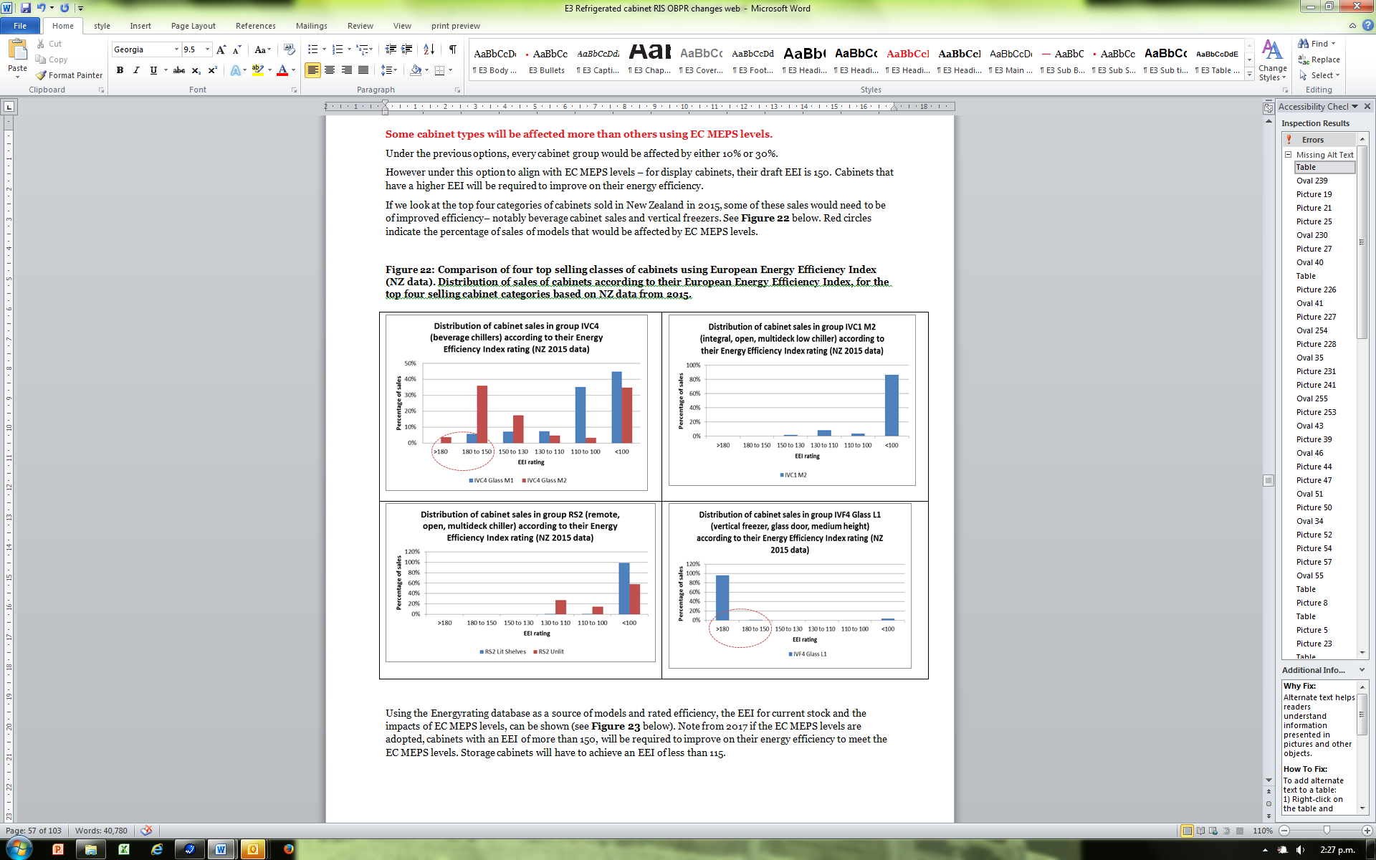
Pg 46: EU MEPS impact: top classes 2015
Some classes more affected than others. (Storage cabinets, give us data)

Slide 51
Implementation Considerations

Slide 52
Deemed to Comply
Under a ‘deemed to comply’ proposal a supplier could avoid full 3rd party laboratory testing by providing a signed declaration that would demonstrate that the product complied with relevant efficiency levels (e.g. by using very efficient components)
This would apply to small production runs and custom made cabinets including built-in cabinets
The ISO standard for display cabinets, allows a ‘deemed to comply’ option called ‘Revised Energy Consumption’ for components to be swapped in an already rated model, without the need for a total retest by using component data or tests on the individual components
The alternate components can be measured or calculated using Formulae in ISO 23953-2:2015

Slide 53
Representative Testing Rules
(UK Enhanced Capital Allowances)
Variation between models | Selection rule
Cosmetic differences to the exterior | Any model may be selected to be the representative model
Heaters (door, trim etc.), fans, defrosts, lighting and other acc. | The model with the greatest direct electrical energy consumption must be the representative model
Temperature level | The model with the lowest temperature setting must be the representative model
Length | The representative model must have a length of between 2.25 and 2.80m. This length of model can only be used to represent models between 1.80m and 5.00m in length; and separate data must be submitted for each model outside of these limits
Type of doors | Where some variants have sliding doors and some have hinged doors, the representative model should be equipped with hinged doors
Cabinet depth | The model with the greatest cabinet depth must be the representative model
Shelves | The model with the lowest number of shelves must be the representative model
Front-opening height (throat) | The model with the largest front-opening height (throat, must be the representative model
Two or more of the above variations | The rules set out above must be combined when selecting the representative model
Representative Testing identifies the least efficient scenario

Slide 54
Custom-built cabinets or low-volume supply
Consultation Questions:
16. What issues might arise for you (or your competitors) if you supply custom-made cabinets?
17. What might help you easily comply with the proposed regulations, if you supply built-in, custom-made, or a small number of cabinets?
18. Please suggest how we could define ‘custom-made’, ‘built-in’ or low-number-of supply cabinets (if different from the suggested wording in the EC regulations)?
(Custom-made refrigerated commercial display cabinets made on a one-off basis according to individual customer specification and not equivalent to other refrigerated commercial display cabinets placed on the market, EU Directive 2009/125/EC )

Slide 55
Definition of foodstuffs
A ‘food product’ in terms of AU and NZ food standards is effectively ‘anything that is intended or offered for human consumption’ (i.e. fish bait cabinets not covered)
Proposed EU Regulations includes those cabinets sold for the refrigeration of items other than foodstuffs, however exclude:
  Cabinets specifically designed for the storage of medicines and scientific samples
  Refrigerated cabinets for the sale and display of live foodstuff, such as living fish and shellfish, refrigerated aquaria and water tanks
  Wine storage appliances
Should we follow the EU and include items other than foodstuffs in the definition of the application of refrigerated cabinets, but have specific exclusions for items such as pharmaceuticals, vaccines?

Slide 56
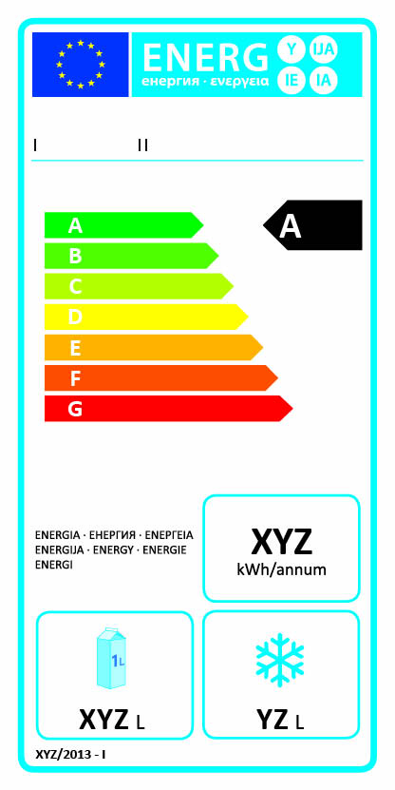
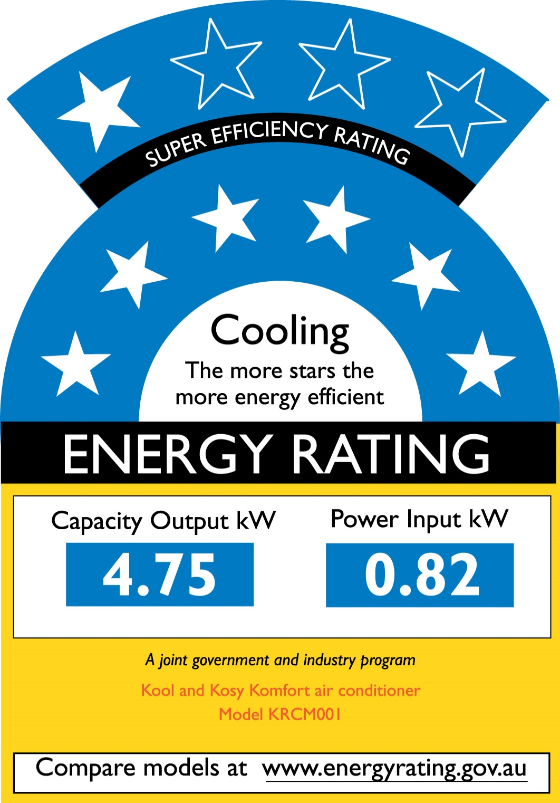
Labelling options
✬ tell us what you want
Mandatory for Storage cabinets in EU now.
pending for display cabinets.
  …a printed label is provided……electronic label is made available…
  …add, price, tender containing energy-related info – includes reference to energy class…
Au-NZ Mandatory means ‘stuck to the product’ or in the box. Not online/in literature. Star rating (not grades)
Voluntary online labelling possible – in partnership with rules (online/in literature)

Slide 57
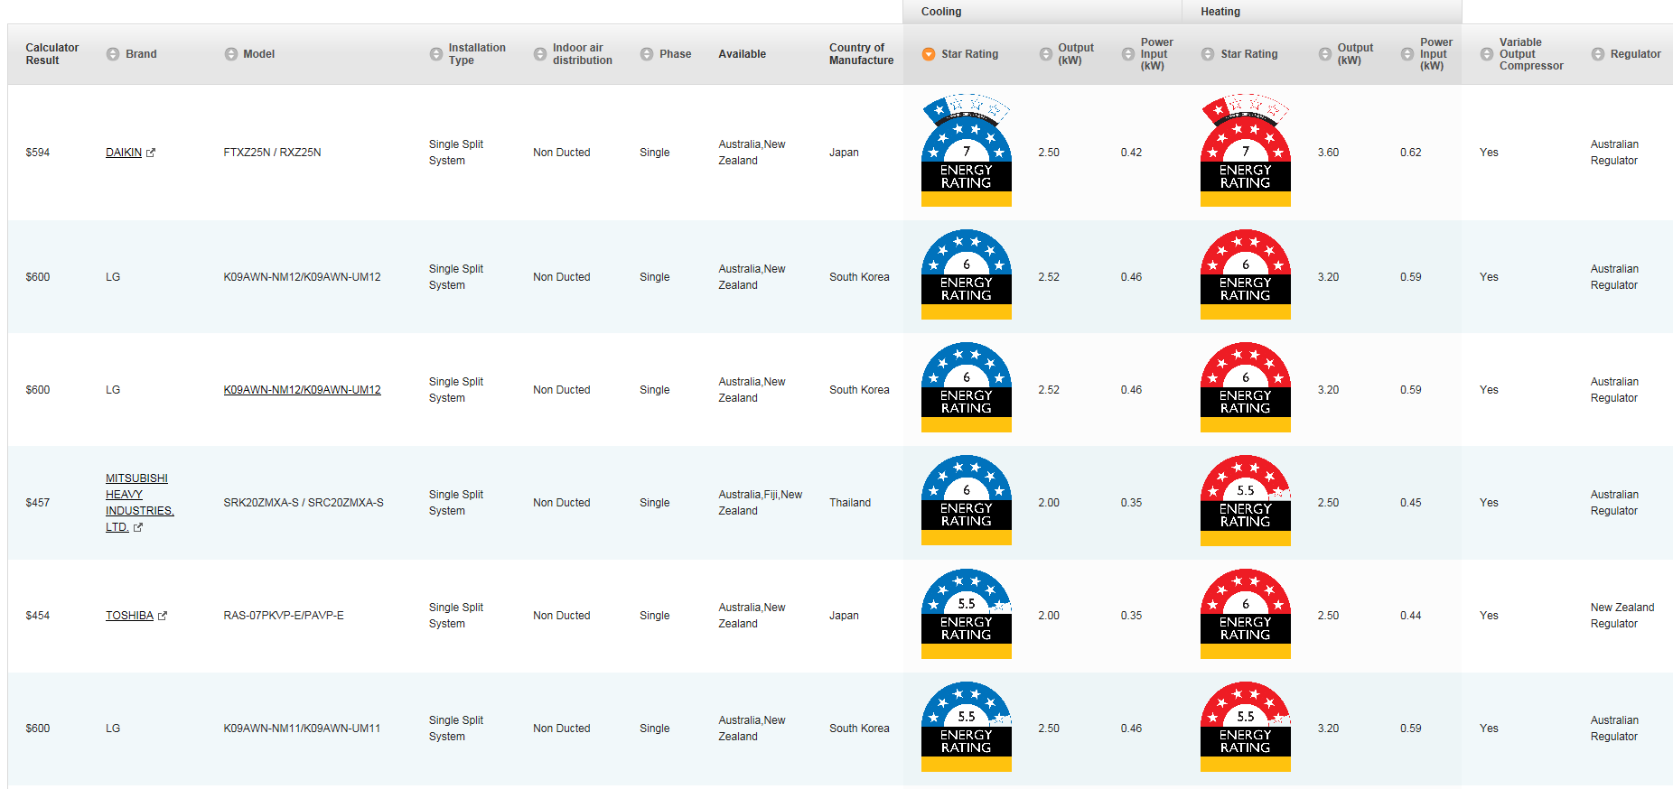
e.g: Mandatory labels used voluntarily online
Air conditioners
Mandatory fields in registration database generate label visual online.
Auto-populates in a search.

Slide 58
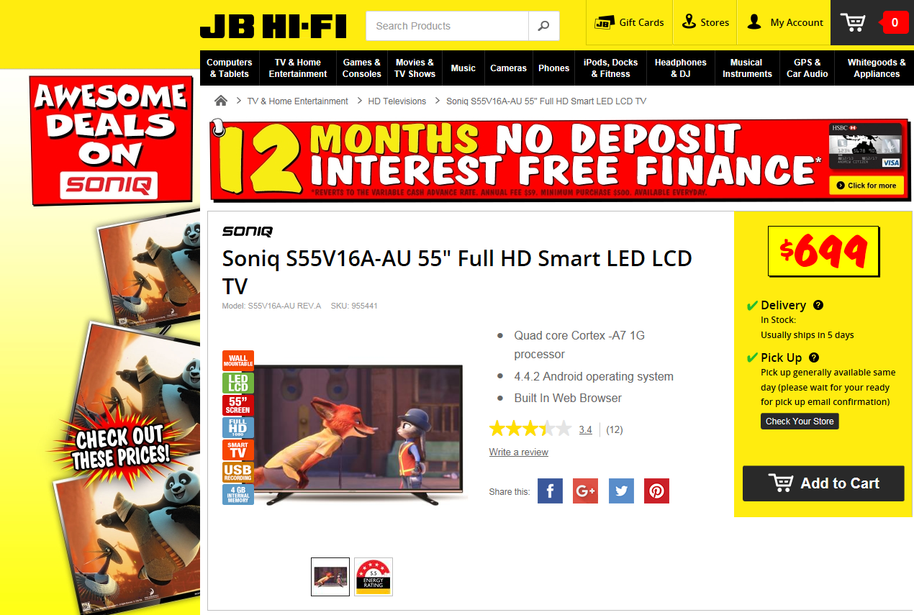
e.g: mandatory labels in voluntary partnership (TVs in Au)
Partners use label within agreed guidelines. Auto-populates.

Slide 59
Energy Modelling and Cost Benefit Analysis

Slide 60
Energy/Stock Modelling & Cost Benefit Analysis
Methodology
Energy/Stock Modelling and Assumptions
  Key features and assumptions
  Stock estimates + Business as Usual (BAU) Energy
CBA Modelling + Results
  Approach
  Energy efficiency and price/cost changes due to policy scenarios
  CBA outputs by policy option

Slide 61
Methodology – Basic Approach
Bottom up engineering model
  This approach = national & international best practise
  Combined with energy costs, price of efficiency, government/program costs
Model attributes used/produced
  Inputs: Annual sales, life, efficiency, size, GHG emission factors, energy prices, price of efficiency improvements, program costs
  Outputs: Energy/GHG by year, stock installed, costs and benefits
Scenarios: attributes are potentially adjustable due to
  Regulations, programs or market changes
  BAU trends (natural efficiency changes)
Fundamentally a complex stock model that includes energy characteristics of stock combined with costs and benefits

Slide 62
Methodology – Key Features
Energy use is characterised by:
  Efficiency = TEC/TDA as per Standard
  Annual Energy = TEC/TDA x Avg TDA x 365
Autonomous efficiency improvement of 0.3% p.a.
15 Grouped categories based on ISO classifications

Slide 63
Data and Assumptions
Efficiency + size
  Sales weighted values from registration data and NZ sales data and projected forward post 2013 (estimated for RSC)
  Assumed that NZ sales weighted efficiency and size were the same as AU
Life
  Based on survival curve, varies for each product category
  Integral RDC 11 years, Remote RDC 13 years, and Storage cabinets 11 years
Annual sales (see earlier slide)
Electricity prices and GHG emission factors
  Sourced from government research (documented in RIS)

Slide 64
Stock Outputs - Australia
1.25 Million in 2030
758,000 in 2013

Slide 65
Stock Outputs – New Zealand
240,000 in 2030
148,000 in 2013

Slide 66
BAU – Energy Consumption (GWh p.a)
Equates to 10% of commercial energy consumption and 2.5% of total in AU in 2013/4
Equates to 12% of commercial energy consumption and 2.9% of total in NZ in 2013
Source: Australian Energy Statistics 2015
AU Total 2013-14 = 248,333 GWh
Source: Ministry of Business, Innovation & Employment 2016, NZ Total 2013 = 38,781 GWh

Slide 67
Cost Benefit Analysis
Benefits
  Reduced annual electricity running costs to the consumer
  Simplification of regulations (not quantified)
Costs
  Increased price of equipment due to efficient components (more metal/technology)
  Government administration
  Product suppliers for testing/administration

Slide 68
Cost Benefit Analysis - Energy Assumptions
MEPS – applied to each of 15 groups
  Option 2+ 3: by removing bottom 10%, 30% of registered models per group, model calculates resulting increase in sales weighted efficiency
  Option 4: Adopt EC 2017 MEPS, removes from sale models that do not comply, model calculates resulting increase in sales weighted efficiency
Labelling
  Sales weighted efficiency is assumed to increase above BAU by 0.5% p.a. for 5 years post label introduction (source: evaluations of other labelled products)

Slide 69
Cost Benefit Analysis - Price Efficiency Relationship
PE ratio is the ratio of the percentage increase in both price and efficiency:
  Detailed analysis of multiple efficiency measures (LED, EC fans, HE doors, electronic thermostats, etc.) applied to different cabinets
  Cost impact was derived for all the units and price efficiency ratio of 0.5 was found
  i.e. incremental prices are increased by 5% for each 10% improvement in efficiency
5% p.a. reduction in costs was applied to account for the learning effect

Slide 70
Cost Benefit Analysis - Other Costs
Total incremental cost to Government
  $240,000 p.a. to $290,000 p.a.
Industry Costs
  Incremental cost per supplier per year ranged from $18,000 to $35,000
  Model test cost is around $6,500 each
    50 more may be tested as they just passed MEPS
  Registration fees were not included as they are treated as a “pass through” to government

Slide 71
Options Under Consideration
 | Option 1 – BAU | Option 2 –EN and ISO test methods, AU/NZ MEPS 10%, labelling | Option 3 – EN and ISO test methods, AU/NZ MEPS 30%, labelling | Option 4 – EN and ISO test methods, EC MEPS, labelling | Option 5 – non-regulatory options (in addition to BAU
Move to International ISO and EN test methods | ✗ | ✓ | ✓ | ✓ | ✗
New AU/NZ MEPS levels | ✗ | ✓ | ✓ | ✗ | ✗
EC MEPS levels | ✗ | ✗ | ✗ | ✓ | ✗
Labelling | ✗ | ✓ | ✓ | ✓ | ✓
Modelled date of implementation | N.A. | 2017 | 2017 | 2017 | Not Modelled

Slide 72
Results – CBA Option 2 – MEPS 10%+Label
Values to 2017 to 2035, present value discounted 7% AU, 5% NZ
Measure | Australia | New Zealand
Total Benefit ($m) | 606 | 142
Total Cost ($m) | 58 | 15
Benefit Cost Ratio | 10.5 | 9.3
Energy Saved (GWh cumulative) | 5,976 | 1,146
GHG reduction (kt CO₂-e cumulative) | 5,481 | 108

Slide 73
Results – CBA Option 3 – MEPS 30%+Label
Values to 2017 to 2035, present value discounted 7% AU, 5% NZ
Measure | Australia | New Zealand
Total Benefit ($m) | 1,641 | 383
Total Cost ($m) | 211 | 55
Benefit Cost Ratio | 7.8 | 6.9
Energy Saved (GWh cumulative) | 16,749 | 3,223
GHG reduction (kt CO₂-e cumulative) | 15,381 | 306

Slide 74
Results – CBA Option 4 – EC MEPS + Label
Values to 2017 to 2035, present value discounted 7% AU, 5% NZ
Measure | Australia | New Zealand
Total Benefit ($m) | 1,748 | 408
Total Cost ($m) | 225 | 59
Benefit Cost Ratio | 7.8 | 6.9
Energy Saved (GWh cumulative) | 18,130 | 3,501
GHG reduction (kt CO₂-e cumulative) | 16,653 | 333

Slide 75
CBA Results Summary
Australia
Option | Energy Saved (cumulative to 2035 - GWh) | GHG Emission Reduction (cumulative to 2035) Mt | Total Benefit ($M) | Total Investment ($M) | Net Benefit ($M) | BCR
Option 2 | 5,976 | 5.5 | 606 | 58 | 548 | 10.5
Option 3 | 16,749 | 15.4 | 1,641 | 211 | 1,430 | 7.8
Option 4 | 18,130 | 16.7 | 1,748 | 225 | 1,523 | 7.8
New Zealand
Option | Energy Saved (cumulative to 2035 - GWh) | GHG Emission Reduction (cumulative to 2035) Mt | Total Benefit ($M) | Total Investment ($M) | Net Benefit ($M) | BCR
Option 2 | 1,146 | 0.1 | 142 | 15 | 127 | 9.3
Option 3 | 3,223 | 0.3 | 383 | 55 | 328 | 6.9
Option 4 | 3,501 | 0.3 | 408 | 59 | 349 | 6.9

Slide 76
Consultation Questions
Labelling:
  Q6. What impact would efficiency labelling of cabinets in literature/websites/on the cabinet itself, have on buyers and users?
  Q15. On Price and consumer Choice?
Price:
  Q10. Assume that the price of cabinets won’t change significantly from proposed changes to regulation. Do you agree?
  Q11. Are there types of cabinets or situations where improving efficiency of a cabinet would significantly change the cabinet purchase price?

Slide 77
Consultation Questions
Unintended consequences of regulation:
  Q13. What unintended outcomes might arise from improving the efficiency requirements for refrigerated cabinets?
  Q14. Assumed that changes in energy efficiency will be largely invisible to buyers. Cabinets will remain user-friendly and won’t change their functionality and safety (e.g. force all open cabinets off the market, compromise cooling ability, diminish support industries)

Slide 78
Standards working group
Calling for nominations for the group
Work outside AS Standards process for most part
Expected to go through all proposed standards – inclusions, exclusions
Go through all proposed EU regulations for MEPS relevant details
Adapt test standards and EU regs for Au-NZ market
Could meet ~5 times, first one = face to face
September 2016 – March 2017 (or later)
Develop Regulations that have strong compliance & enforcement ability

