Slide 1
Proposed changes to air conditioner regulations
17 March 2017

Slide 2
Decision Regulation Impact Statement – Option A
Zoned Energy Rating Label and SEER rating
Include portable air conditioners
Include air conditioners >65kW
Technical fixes
Increase New Zealand MEPS

Slide 3
Decision Regulation Impact Statement
Option B – Option A plus MEPS for single duct portables
Option C – Option B plus increased MEPS for air conditioners >65kW

Slide 4
Implementation of new regulations
1 April 2019 start date – for most air conditioners
1 October 2017 (estimated) – double duct portable air conditioners
1 October 2020 – 65kW plus air conditioners

Slide 5
Transition to new requirements
Currently in scope – can be sold for remainder of registration and use existing energy label
Voluntary use of the new label
Products newly in scope – grandfathered if can’t comply
Update fee for existing registrations

Slide 6
MEPS and labelling requiremtns
Specified in GEMS Determination
Comments on draft open to all
Four week comment period
Any changes will be re-distributed for further comment before being finalised

Slide 7
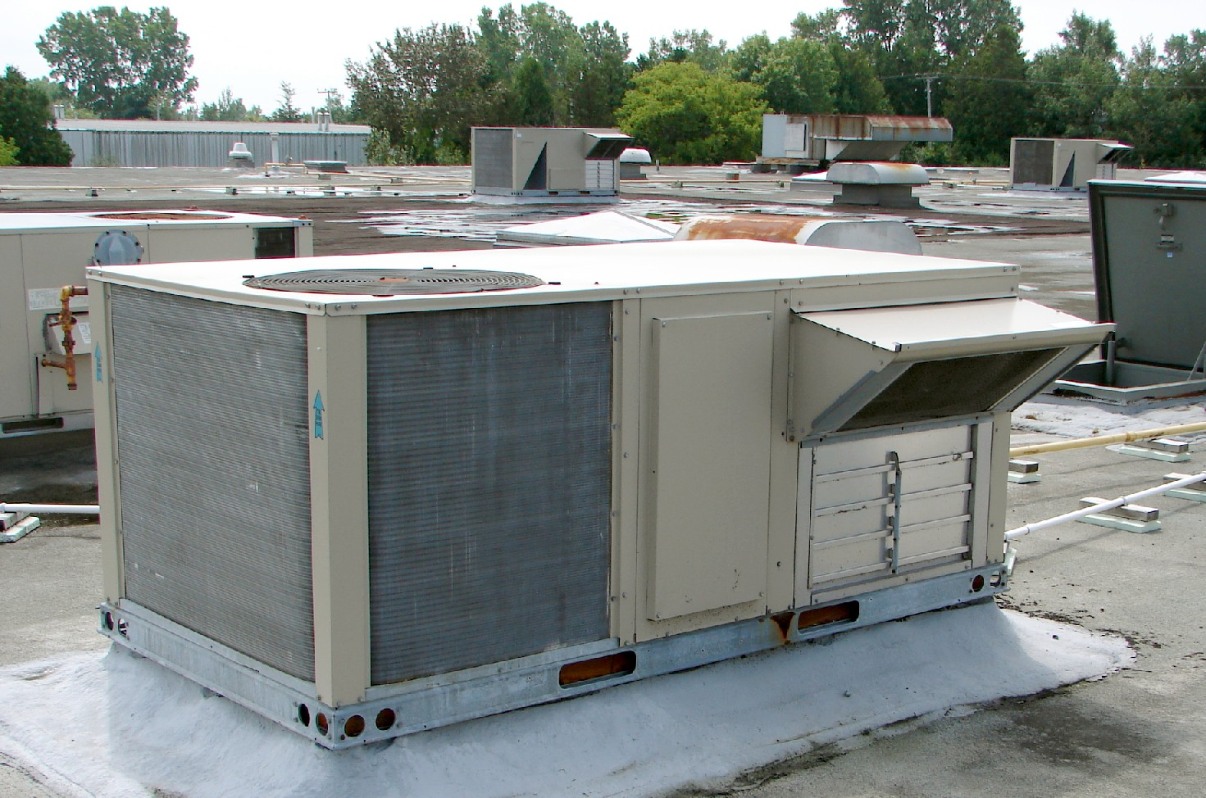
Commercial air conditioner > 30 kW temperature bins

Slide 8
AS/NZS 3823.4 Amendment 1
Has three zones – Hot/humid, cold & mixed.
Defines cooling and heating seasons for each.
Defines outdoor temperatures at which cooling and heating is required.
Tallies all of these hours and applies a percentage to them to account for the likelihood of use.
Designed with a domestic application in mind.

Slide 9
Commercial use applications >30kW
The supplementary consultation paper asked if products > 30 kW should be rated using different user assumptions. Three submissions agreed.
New temperature bins and zero load temperatures will be defined for products >30 kW.
Note, this DOES NOT affect testing requirements.

Slide 10
Commercial use applications (>30kW)
To develop these bins, E3 will:
Develop the required amendments in consultation with industry.
Publish them on the Energy Ratings website and distribute them widely.
Publish them in the DRIS and Determination.
Update AS/NZS 3823.4 to match the regulations at the next opportunity.

Slide 11
Representative commercial use
There are thousands of different commercial use patterns. The challenge is to settle on reasonably representative ones for the three zones.
Propose to use the 2012 COAG repot Baseline Energy Consumption and Greenhouse Gas Emissions In Commercial Buildings in Australia to help guide the process.

Slide 12
Baseline report findings
Looked at stock of:
Standalone offices
Hotels
Retail
Hospitals
Schools
Universities
VET buildings
Public buildings
Law courts

Slide 13
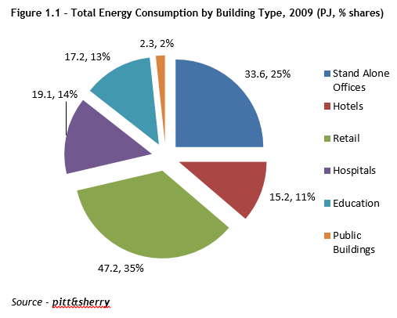
Baseline report findings

Slide 14
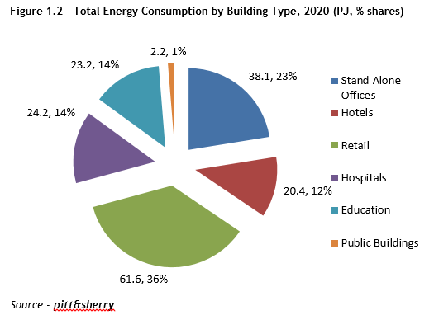
Baseline report findings - 2020

Slide 15
Baseline report findings – hours of use
All shopping centre retail areas: 79 hrs/week
  96 hours per week for supermarkets
  59 per week for other tenancies
Proposed operating schedule
  7.00 am to 7 pm
  Monday to Saturday
  72 hours per week

Slide 16
Proposed cooling/heating temperatures
Commissioned Dr Paul Bannister (Energy Action) to look at t=0 and t=100 for the 3 zones.
Modelled thermal loads versus outdoor temperatures for three buildings in the three climate zones to find average values.

Slide 17
Consultation process
Please distribute the papers to interested parties.
Feedback sought by COB 18 April 2017.
Standards Committee EL-056 support will be sought before the final outcome is published on the Energy Ratings website – aim is the end of April 2017.
Questions?

Slide 18
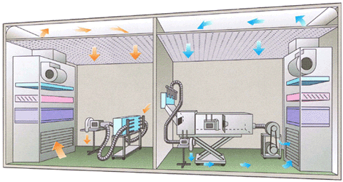
New testing requirements

Slide 19
Consultation processes
In response to feedback on the supplementary consultation paper, we looked closely at the testing requirements. The aim was to:
Minimise costs and difficulty where possible.
Create a range of flexible options.
Maintain acceptable accuracy.

Slide 20
H2 testing
Air enthalpy will be permissible for all products.
The duration of a calorimeter test at H2 can be shorted from 6 hours (or 6 complete defrost cycles) to 3 complete defrost cycles.
These arrangements are also applicable to voluntary H3 tests (i.e. minus 7 ˚C).
When practical, E3 will still use a full calorimeter room test for compliance purposes.

Slide 21
Mandatory versus optional testing
The SEER standard contains a number of “mandatory” and “optional” tests.
E3 will not require the “optional” tests, however research indicates that performing the “optional” tests can significantly improve a product’s SEER ratings.

Slide 22
Using default SEER values
The SEER standard has two mandatory cooling tests for fixed speed products:
  Rated capacity T1 (35 ˚C ) test (already required).
  Capacity at 29 ˚C.
The 29 ˚C test will be made optional. Results can rely on the default values for this test.
Variable speed products may also be tested as a fixed speed. For a reverse cycle unit, this will reduce the testing from 5 to 3 or 4 tests.
While these measures reduce testing costs, the SEER values will be sub-optimal.

Slide 23
Testing options for products > 30 kW capacity
Eurovent certification.
AHRI certification for cooling.
Equivalent regional adoptions of our ISO test standards.
Simulation testing – any software may be authorised.
However, ratings must be to local voltage and frequency requirements. Declarations of inoperative power and true power factor still required.
When practical, E3 will still use a calorimeter room check test for compliance.

Slide 24
Other requirements
The maximum cooling test will no longer be a requirement.
For a registration test report, test labs do not need to be from Australia/New Zealand, nor do they need to be National Association of Testing Authorities Australia (NATA) accredited.

Slide 25
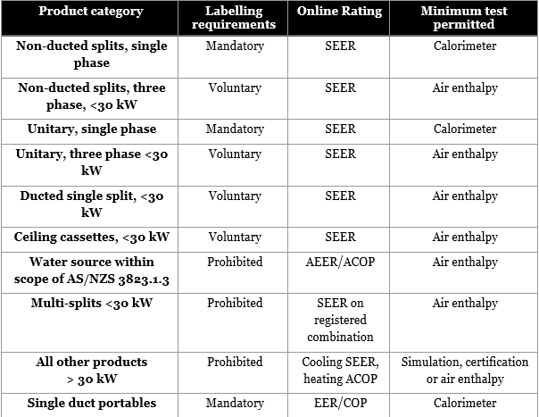
Labelling requirements

Slide 26
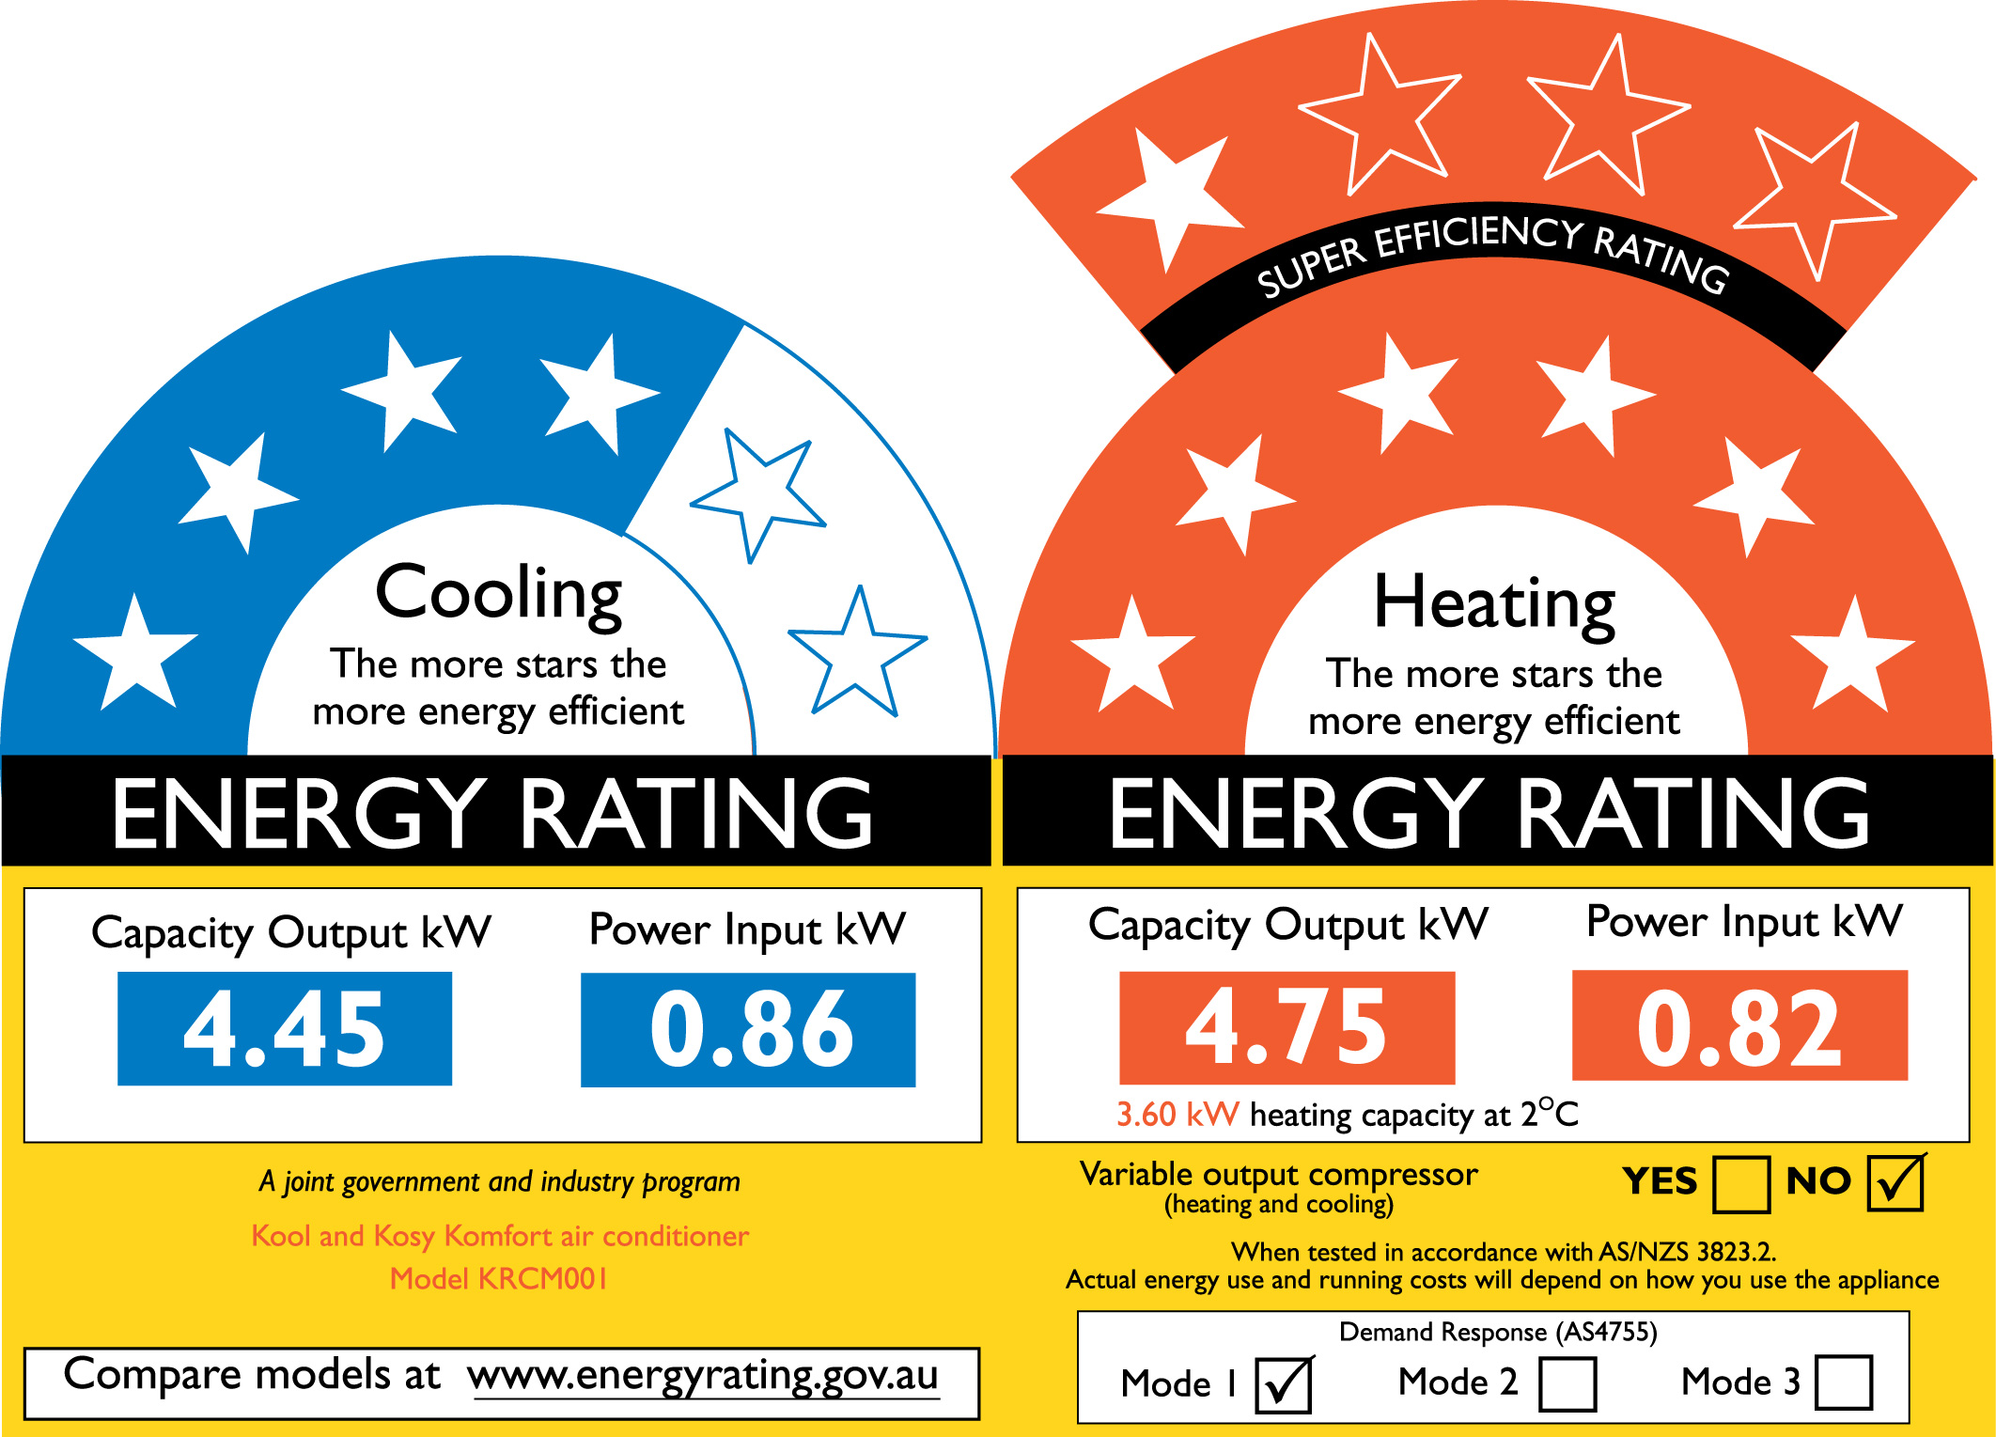
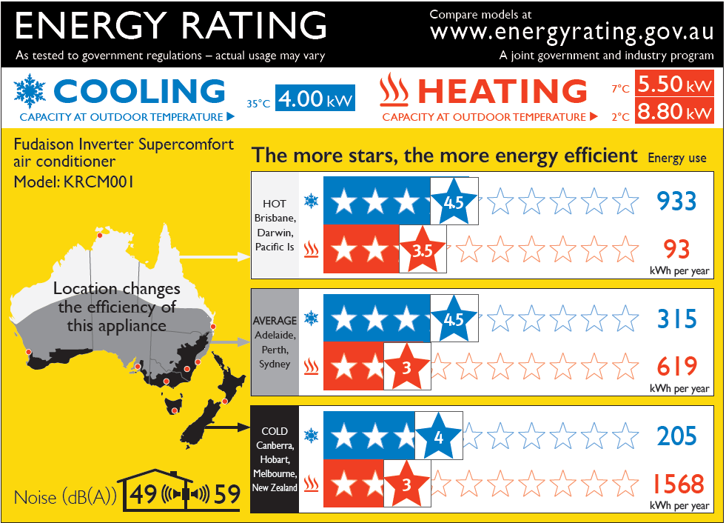
Zoned Energy Rating Label

Slide 27
Zoned Energy Rating Label
Displays efficiency and energy consumption across three distinct climate zones (Australia and New Zealand)
Opportunity to display additional information valuable to consumers (and installers)
Further online tools to give engaged consumers more detailed information (and for retailers to use as a selling point)

Slide 28
Developing the Zoned Label
E3 agreed to investigate the development of new label in March 2013
Multiple rounds of graphic design, technical research and both qualitative and quantitative testing
In total, approximately 4500 consumers, retailers and installers attended focus groups, interviews and participated in online surveys and forums

Slide 29
2017 testing
Final round of testing to finalise design
Online quantitative component, focus groups and online forum
Focus on capacities (particularly H1/H2) and noise
Broad overall impressions
Report on Energy Rating

Slide 30
2017 finalisation
Changed wording for capacity declaration
Updated sound declaration to include word ‘noise’ and enhance speaker shape
Increased size of text and adjust wording
Removed QR code

Slide 31
The ZERL – non ducted

Slide 32
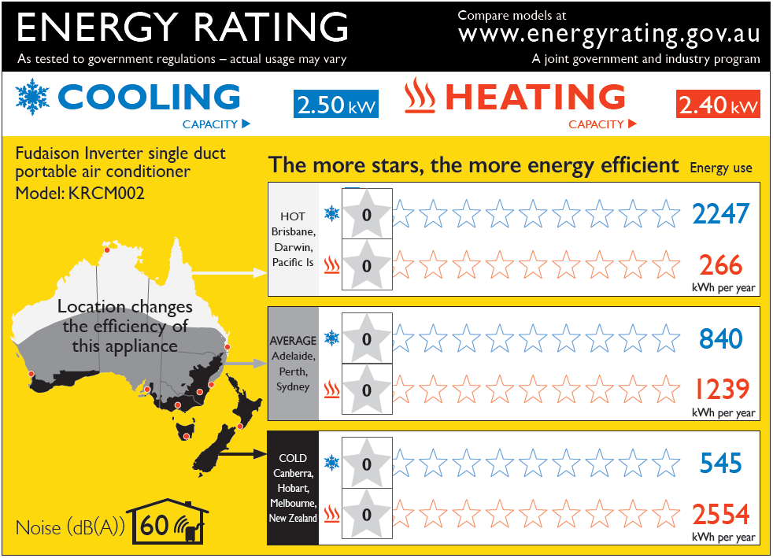
ZERL – single duct portable (r/c)

Slide 33
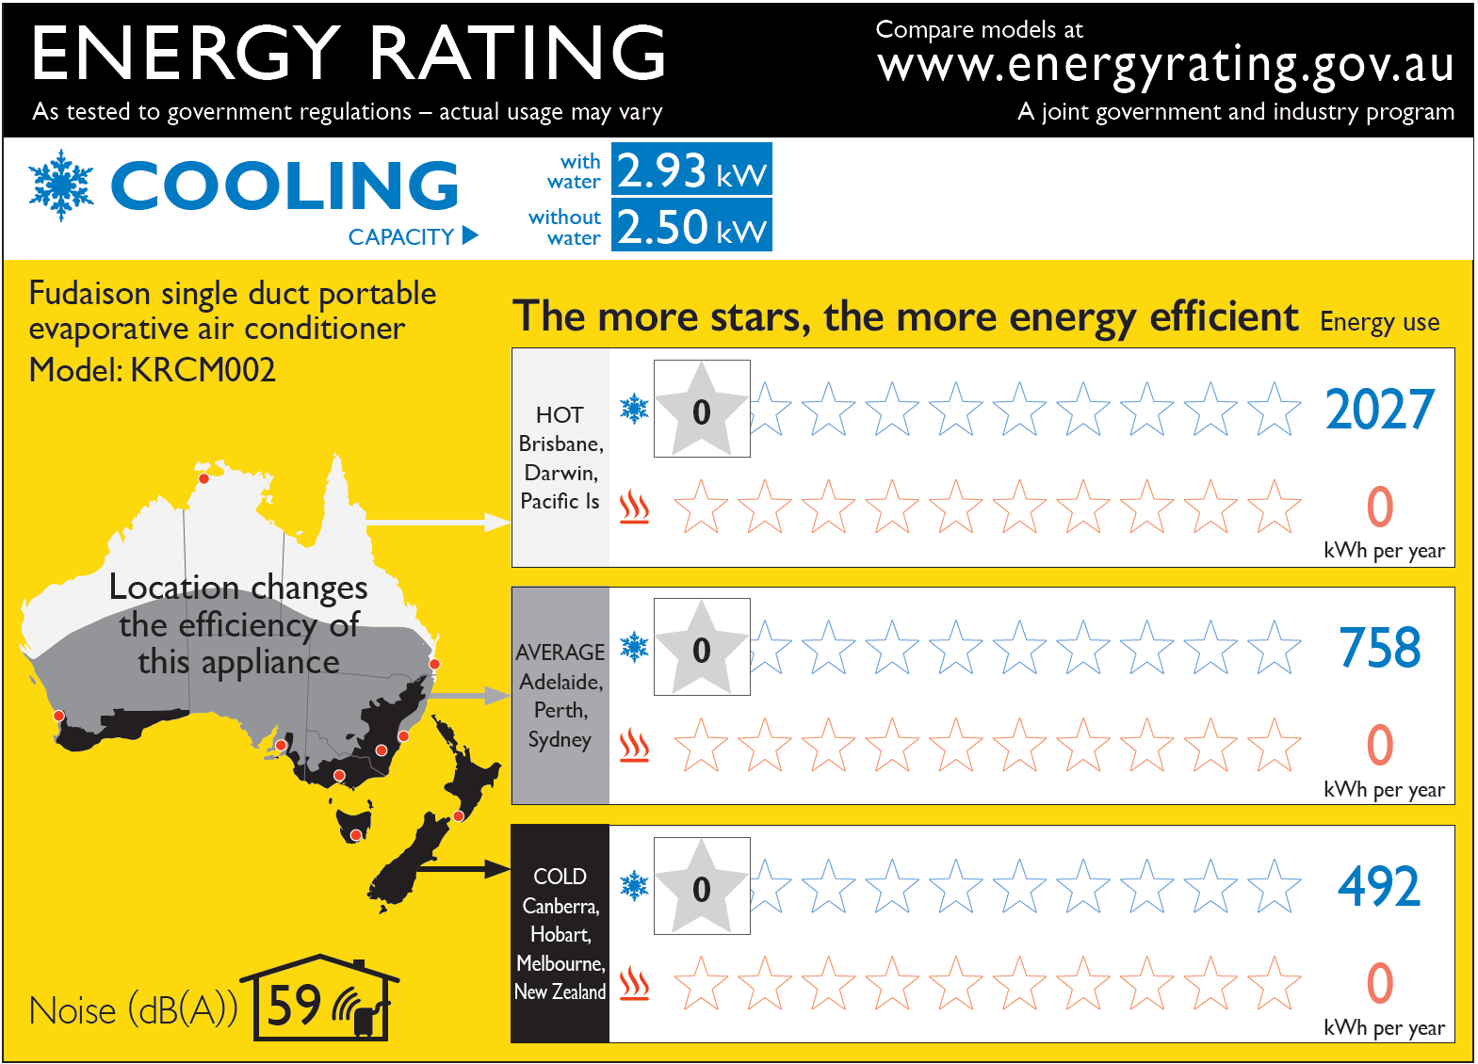
ZERL – single duct portable (cooling only, water evaporation feature)

Slide 34
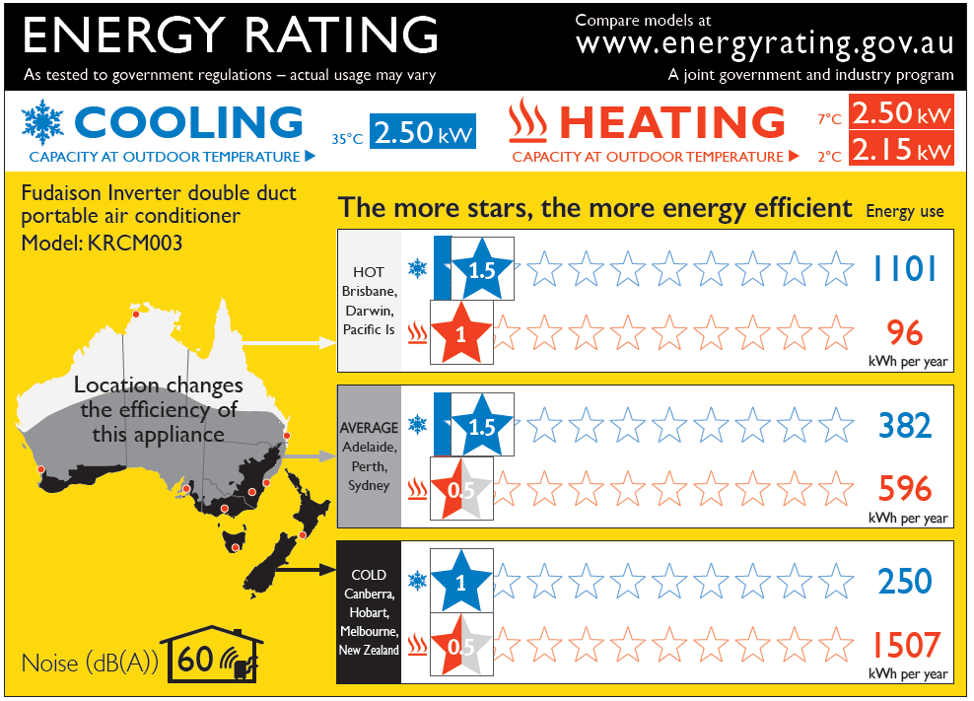
ZERL – double duct portable

Slide 35
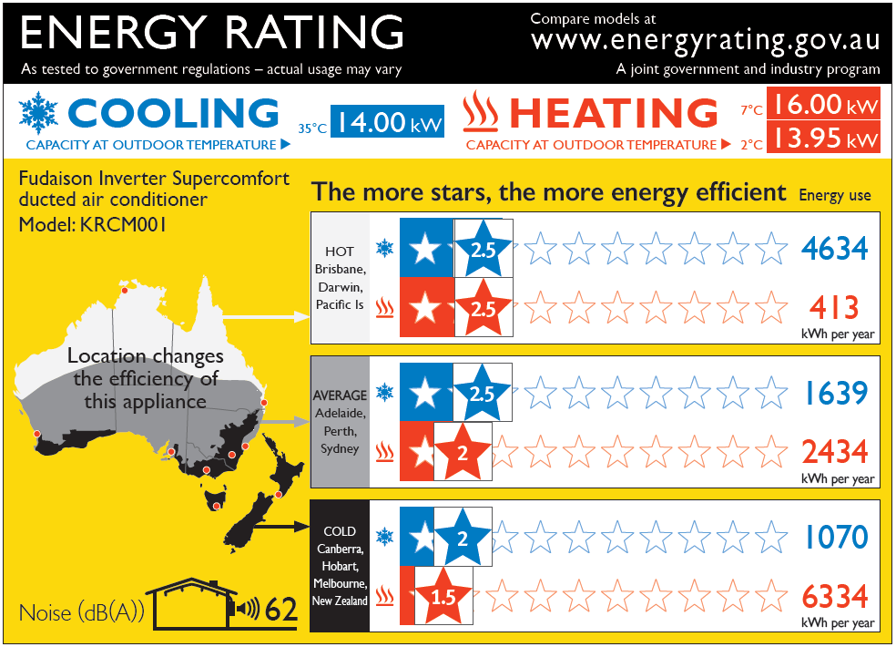
ZERL - ducted

Slide 36
Calculator
rating information more closely tailored to location
more accurate running costs
options to increase or decrease default operating hours (and thus annual energy consumption)
display of greenhouse gas emissions, using localised emissions intensity data
hourly operating costs (rated capacity)

