Slide 1
Air Conditioner Regulation and the Zoned Energy Rating Label
Dr Sam Smith
4 September 2019

Slide 2
Agenda
Brief overview of air conditioner regulation
The new Zoned Energy Rating Label or ZERL, what has changed and why
Changes for portable air conditioners
Retailer responsibilities
  In store
  Online
Registration and compliance
Answers to questions you might be asked by customers
Q&A
Morning tea break
Presentation about the Ozone Protection and Synthetic Greenhouse Gas Program

Slide 3
Introduction to energy efficiency regulation
The Australian Government has set minimum energy efficiency standards since 2012.
This is done through the Greenhouse and Energy Minimum Standards Act 2012 (GEMS Act)
22 products are regulated under the GEMS Act, but only seven products require an Energy Rating Label when displayed in stores.
Each ‘GEMS product’ has a separate legislative instrument (Determination) which sets out:
  Energy efficiency requirements (often referred to minimum energy performance standards or MEPS)
  Labelling requirements (displaying the Energy Rating Label or other labelling requirements)
  Occasionally ‘other’ requirements (often related to product performance or high efficiency requirements)

Slide 4
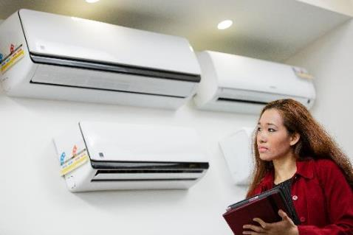
Air conditioning regulation
Regulated for energy efficiency since 2004, but have required an energy label since 1987.
The Determination says what types of air conditioners must display an Energy Rating Label when the unit is on display in a store.
Two recent new Determinations:
  One for units up to 65kW, introducing the new ZERL
  One for units over 65kW

Slide 5
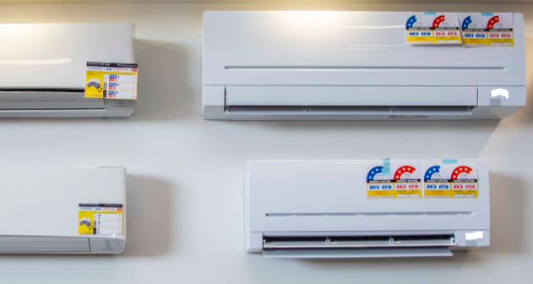
Timeline: what is happening when?
Now: manufacturers or importers can either register their product to get the new label, or they can stick with the old label.
  Result: two different labels in store for up to 5 years
From 1 April 2020: all new models registered, and renewals of older registrations must use the new label.
  Result: portables labelled for the first time
  Result: more models with the new label in store.

Slide 6
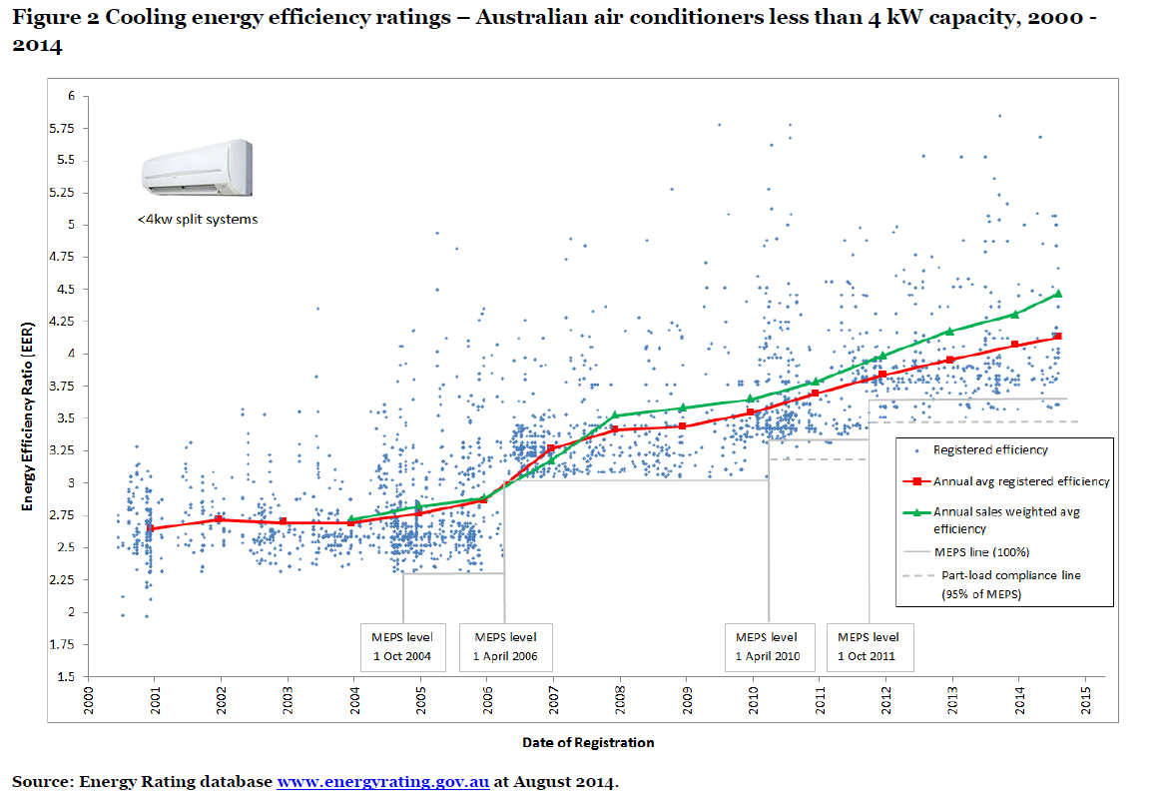
Customers are buying more efficient products
Customers on average are choosing to purchase more efficient air conditioners.

Slide 7
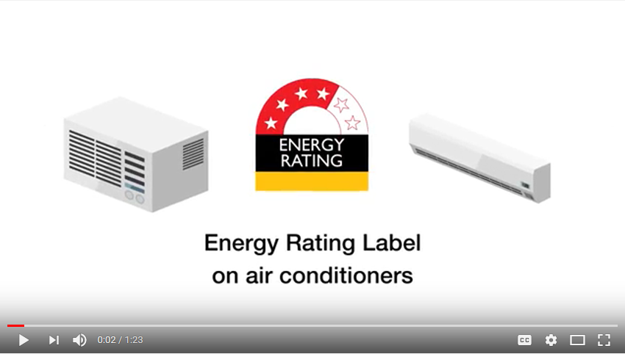
Video about the new label
Access on the Energy Rating YouTube channel

Slide 8
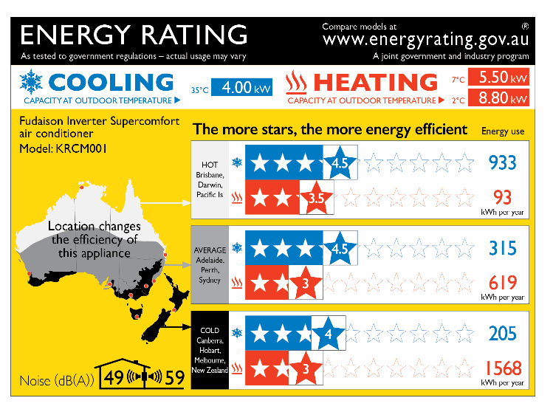
Parts of the Zoned Energy Rating Label
The star rating and electricity use is shown for each climate zone.
This is the cooling capacity if the outside temperature is 35°C.
This is the heating capacity when the outdoor temperature is 7°C.
This is the heating capacity if the outdoor temperature is 2°C.
Brand and model number
There are three climate zones for Australia and New Zealand, as shown on the map:
hot
average
cold.
This is how loud the air conditioner will be inside and outside
Notes:
To see this slide correctly you need to view the presentation in Slide Show mode.

Slide 9
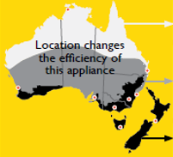
How does climate affect air conditioner performance and efficiency?
Purchasing the right air conditioner for the right zone is important.
It’s not just about how hot it is! It is also about how cold it gets.
In cold climates focus should be on the heating stars.
In hot/humid climates customers should focus more on the cooling stars.

Slide 10
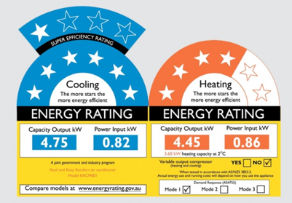
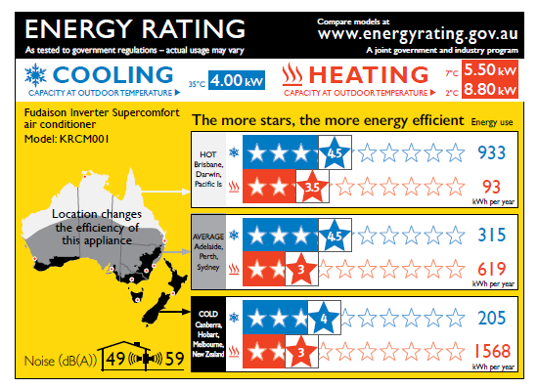
Old label vs. new label:
What’s changed and why?
Old label: Capacity and power in kW
No clear indication of annual power use
Implied same performance all across Australia and New Zealand
New label: Capacity in kW, power use in kWh showing expected annual power use.
Capacity at 2°C.
Zoned rating showing different performance in different conditions
Includes noise ratings

Slide 11
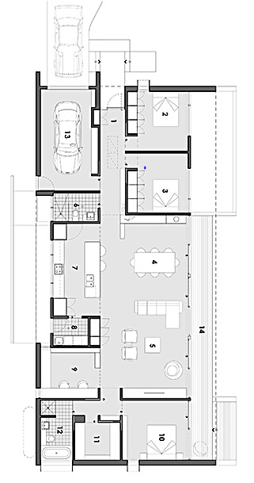
Air conditioner sizing
The MOST important thing for a customer is to get the right size air conditioner for their space.
Note: ‘size’ is the cooling/heating capacity, not the physical dimensions of the air conditioner.
  Too small? Inefficient, air conditioner will be working harder for longer.
  A little too big? This is ok, the unit will still work efficiently.
  Way too big? Too expensive for what they need, becomes less efficient as it will cycle on and off too frequently
For sizing: consider the area of the space to condition, external wall material, insulation, windows, shading and orientation.

Slide 12
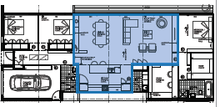
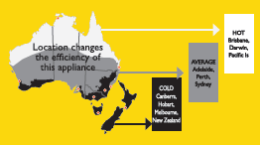
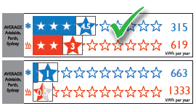
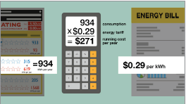
How to use the Zoned Energy Rating Label
Step 1: Find out what size air conditioner you need for your space.
Step 2: Figure out what zone you are in.
Step 3: Compare star ratings on air conditioner performance in your zone.
Step 4: Work out how much it costs to run per year.

Slide 13

Installation
Use a licensed installer
Store retailers should ensure they advise customers to use a licensed technician to install and service their air conditioner. Installers must hold a refrigerant handling license, issued by the Australian Refrigeration Council. lookforthetick.com.au
Portable units can be installed by customers but should still be serviced by someone with a refrigerant handling license.

Slide 14
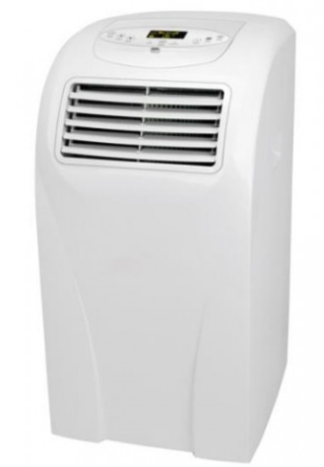
Portable air conditioners
From 1 April 2020 all new portable air conditioners:
  must be registered
  must display a ZERL prior to being sold.
Existing stock in Australia prior to 1 April 2020:
  may be sold until exhausted without registering or displaying a ZERL (some conditions apply).
Portable evaporative coolers do not need to be registered.
The star rating for all single-duct portable units is zero.
If you are unsure about the registration and labelling requirements for any portable units that you sell, please check with your supplier. You can also contact energyrating@environment.gov.au

Slide 15
GEMS Compliance
Background
Air conditioners can only be supplied, offered for supply, or used for a commercial purpose, if:
  the model is registered; and
  the product meets GEMS level, labelling, and Other requirements; and
  the supply, offer, or use complies with the legislation.
  Offence under the GEMS Act to supply or offer to supply air conditioners if they do not display the relevant energy rating label

Slide 16
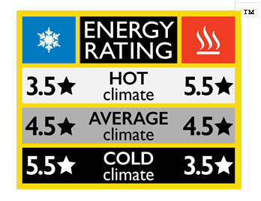
GEMS Labelling Requirements
Displaying the ERL or ZERL
GEMS labelling requirements are set out in the relevant determination.
Each unit of a model supplied or offered for supply must have a label displayed in some form
Clearly visible energy rating labels assist consumers to make informed decisions
ZERL icon available for online or print use
  however, no legal requirement to display
  not used for physical products in store

Slide 17
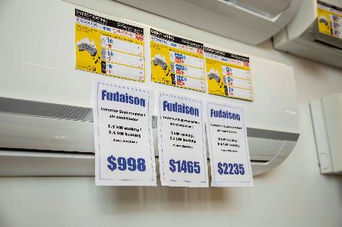
GEMS Labelling Requirements
Displaying the ZERL in retail premises
An example of compliant labelling:
  one ZERL for each model offered for sale

Slide 18
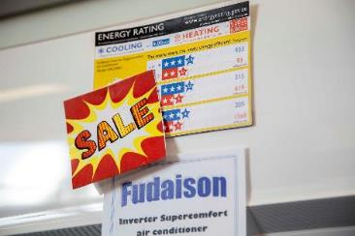
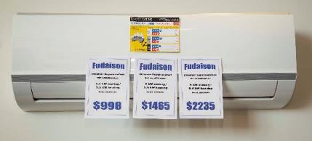
GEMS Labelling Requirements
Display issues
Some examples of non-compliant labelling:
  three models offered for sale but only one ZERL
  please don’t cover the ZERL with store labels
""

Slide 19

Supply via installers
How the ZERL can help
Installers relied upon to assist consumers make the right choice.
ZERL is a great tool to help installers make it easier for the consumer to understand.
Location and climate relevant.
Informed choices.

Slide 20
Things that you might need to know…
How long will there be two labels in stores?
Suppliers can register products to the old Determination up to 31 March 2020.
Registrations are valid for five years.
If registered to old Determination, can only use the old label (ERL).
There is the potential to see the old label in store up until 2025.
We expect that suppliers may move quickly to the new label (ZERL).

Slide 21

Things that you might need to know…
How do I work out the running cost of a product with the ZERL?
Add heating and cooling annual electricity consumption for the relevant zone, then multiply that total by your electricity tariff.
e.g. 933 + 93 = 1026 kWh per year
1026 kWh per year x $0.29 per kWh
  = $297 per year

Slide 22
More of what you might need to know…
How is the annual electricity consumption figure calculated?
Three factors:
  Annual temperature profile in each zone.
  How people use their air conditioners at each temperature
  Electricity use by air conditioners at each temperature
These factors are then combined in an algorithm ending up with annual electricity consumption in each zone.

Slide 23
More of what you might need to know…
Why are there two heating capacities on the ZERL?
Why are there two heating capacities on the ZERL?
The performance of some units is impacted by cold temperatures or frost. The new determination requires testing at 2°C, in addition to the standard rating point of 7°C.
The 2°C heating capacity on the ZERL is useful for customers in cold climates because it is a useful indication of how a unit will perform at lower temperatures, and is a good measure to compare between units.

Slide 24
Even more of what you might need to know…
Why do single-duct portable units have a zero star rating?
Single duct portable air conditioners will blow cold air out of the front of the unit. But…
Single duct portables have no net-cooling effect on a room.
  Creates negative air pressure
  Draws in outside air from gaps, under doorways etc. to balance.
The stars on the ZERL are an indication of how well an air conditioner cools (or heats) a room.
Because the unit does not actually cool down the room, the unit does not achieve any stars.

Slide 25
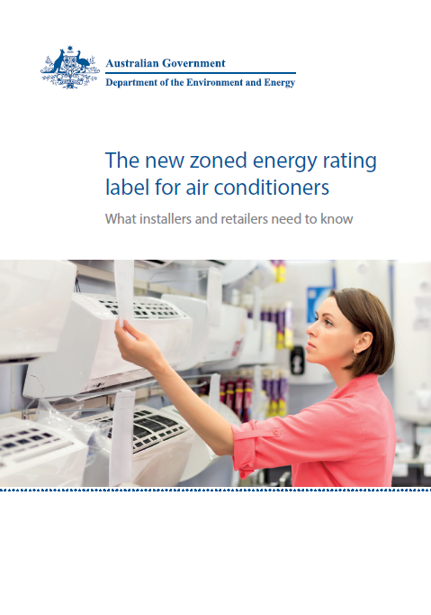
Communications materials to train your staff and inform your customers
We have developed a range of communications materials to help including:
  Information booklet
  Factsheet on how to read and use the ZERL
With further information available on the energyrating.gov.au website
For enquiries contact: energyrating@environment.gov.au
Please fill out the survey form to request copies of these materials
If you have any suggestions on other materials you need, let us know!

Slide 26
Department of the Environment and Energy
Greenhouse and Energy Minimum Standards Regulator
For more information visit energyrating.gov.au
For enquiries email energyrating@environment.gov.au
For more information about installation requirements visit: lookforthetick.com.au
Dr Sam Smith
John Gorton Building,
Parkes, ACT, 2601
Australia
energyrating@environment.gov.au

