Slide 1
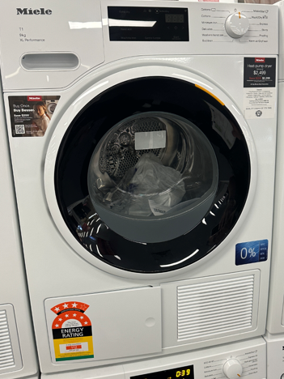
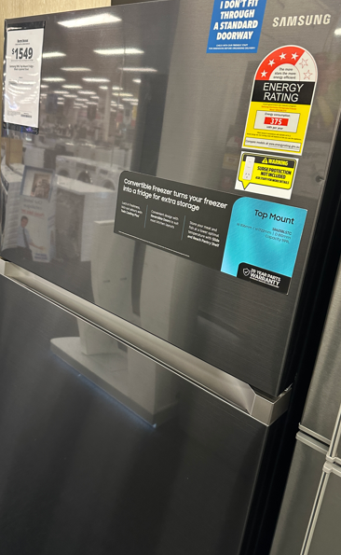
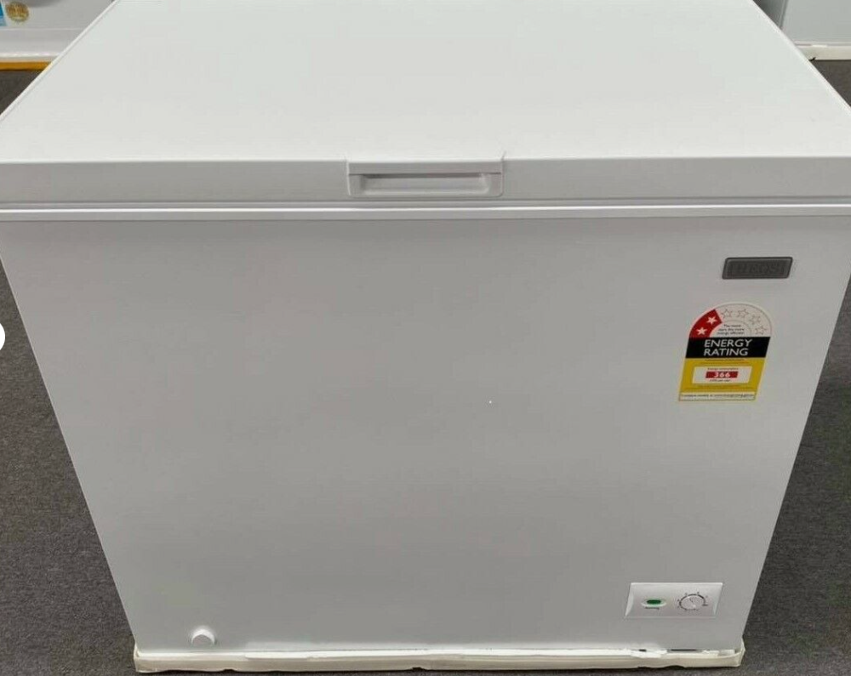
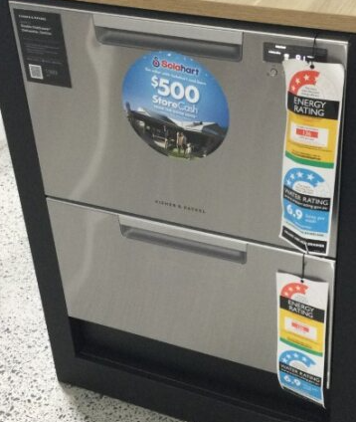
Displaying the Energy Rating Label
This guide supports the correct display of Energy Rating Labels when supplying, or offering to supply, the following products in Australian retail stores.
Clothes dryers
Clothes Washers
Refrigerators
Freezers
Dishwashers
Front of product or packaging.
May be fixed to top but ensure not to obscure it
Front of product or packaging facing the consumer at the top of any display panel on the dishwasher.
If the product is outside its packaging and has more than one opening/draw an ERL must be on each opening.
Upper front of the product facing the consumer or packaging preferred. Lower front is also OK.
May be fixed to top but ensure not to obscure it
Front of product or packaging facing the consumer at the top of any display panel on the refrigerator.

Slide 2
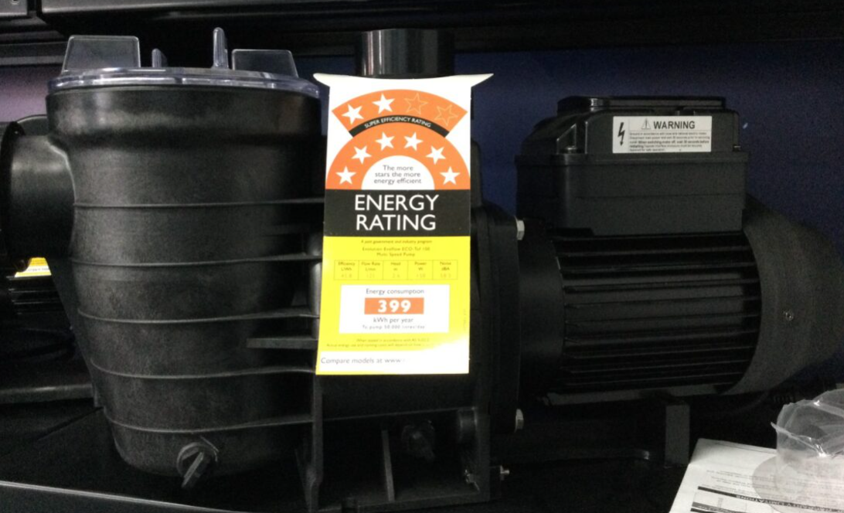
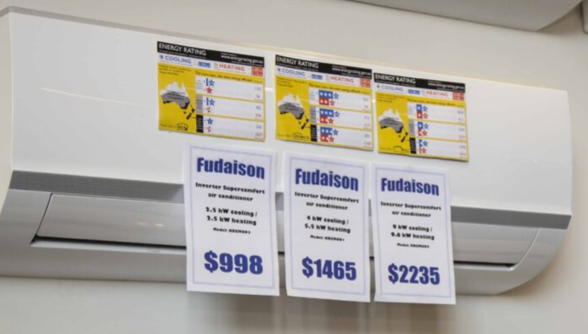
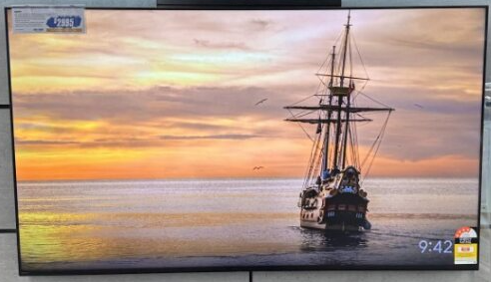
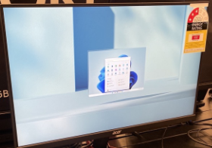
Detailed information for each appliance is available at www.energyrating.gov.au/industry-information/products
Swimming pool pumps
Televisions
Computer monitors
Air Conditioners
Front of product or packaging.
The label must be attached in a way that discourages removal of the label in store.
At least one label clearly visible for the display:
  If out of the box, the ERL must be adhered to the unit or printed on a double-sided swing tag or non-rotating single-sided swing tag.
  if models are packaged — label must be adhered to, printed on or part of the outside of each package.
If there are units of the product on display in a retail store, you must make sure that at least one Energy Rating Label is clearly visible in relation to the display.
Front of the product or packaging is ideal.

